Slide 1
FIFA 2018 Man of the Match Prediction by Vaibhav Javadekar

Slide 2
Problem Statement
Our task is to build a model based on the each match statistics and predict the team to which Man of the Match will be awarded.

Slide 3
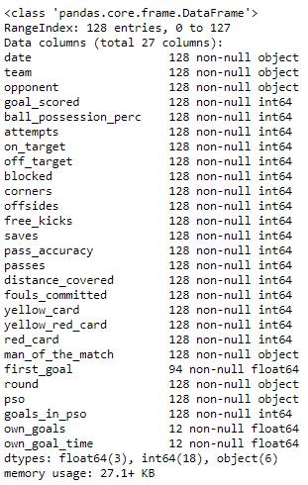
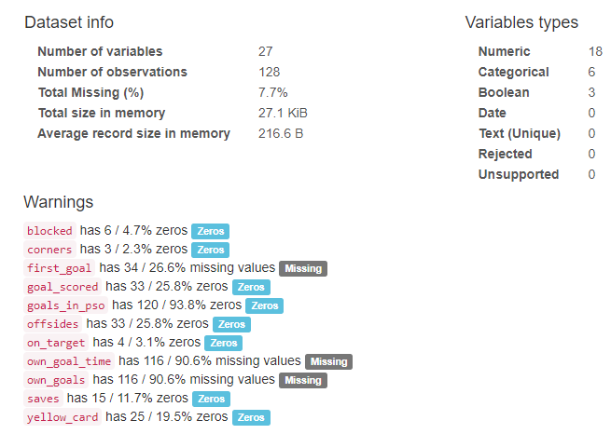
Lets Look at Data

Slide 4
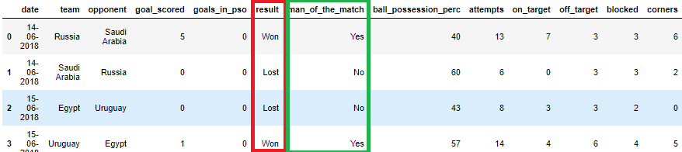
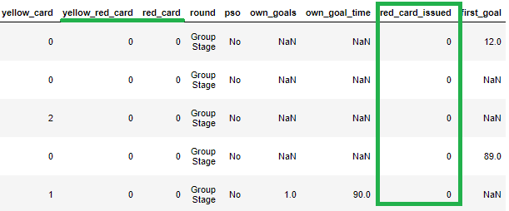
Featuring Engineering
red_card_issued = yellow_red_card + red_card
result = goal_scored + goals_in_pso (Won / Lost / Draw)

Slide 5
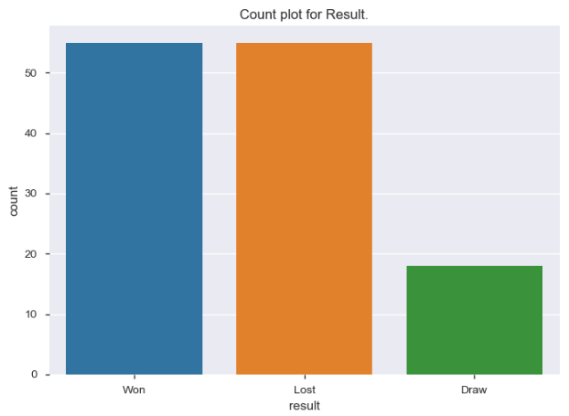

Of all the matches, how many had Result as Won, Lost or Draw ?

Slide 6
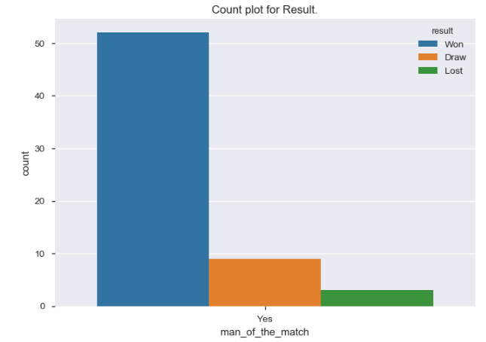
Of all the matches, How many teams received man of the match when grouped by result ?

Slide 7
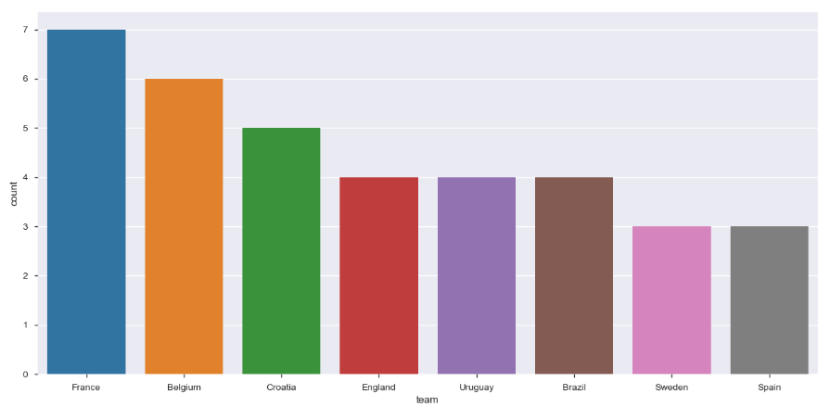
Which are top 5 teams to receive most Man of the Match Awards ?

Slide 8
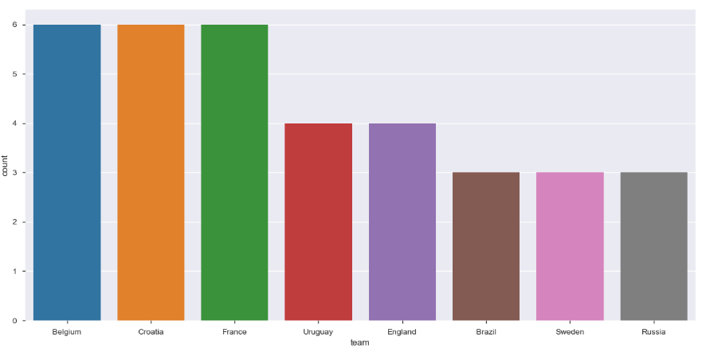
Which are top 5 teams to Won the match ?

Slide 9
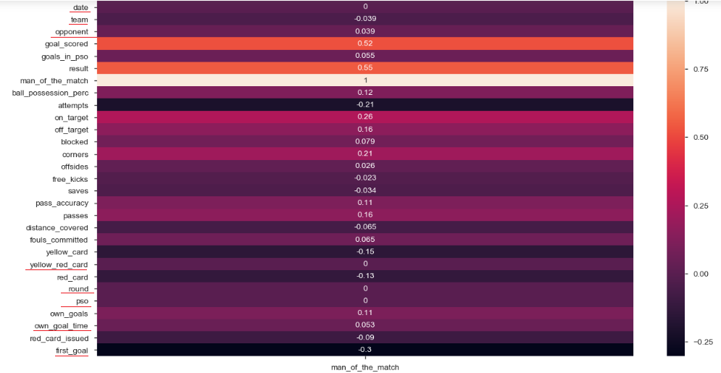
Correlation of features compared to man of the match

Slide 10
Cleaning Dataset
Dealing with missing Values
Own_Goal_Time
Own_Goals
Dealing with data not related to man of the match
First_Goal
yellow_red_card
red_card
Date
Team
Opponent
round

Slide 11
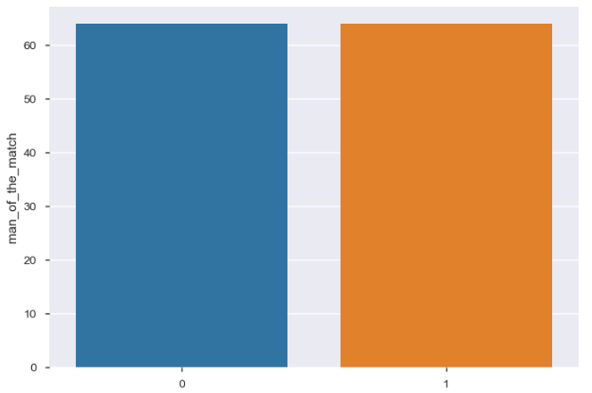
Target : Balanced Dataset
Here we see that target variable is balanced hence we shall use Accuracy to evaluate our model.

Slide 12



Algorithms Confusion Matrix
Logistic Regression
Random Forest Classifier
Decision Tree
Random Forest Classifier with custom Hyper Parameters
Decision Tree with Grid Search

Slide 13



Precision, Recall and F1 Scores

Slide 14
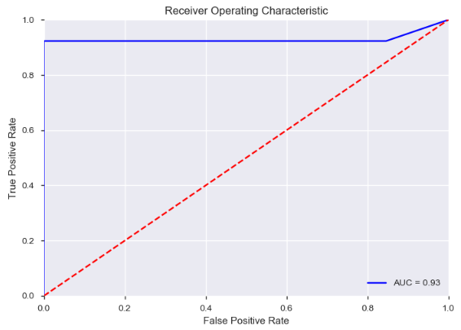
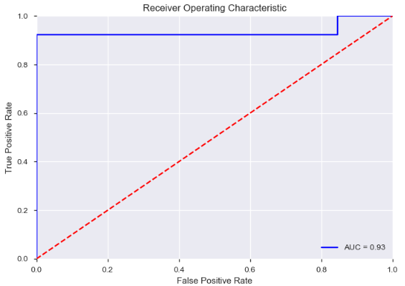
AUC ROC
Random Forest Classifier
Random Forest Classifier with custom Hyper Parameters

